Slide 1
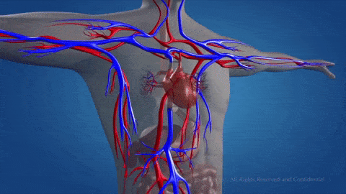
Cardiovascular Risk Prediction
TEAM MEMBERS
Saurabh Arawad
Aman Guleria
Rishika Rai

Slide 2
Content
1 | Steps in Supervised classification | 3
2 | Problem Statement | 4
3 | Data Summary | 5
4 | Missing Value Treatment | 7
5 | Exploratory Data Analysis | 8
6 | Outlier Treatment | 16
7 | Correlation Analysis | 17
8 | Feature Engineering | 18
9 | Data Preprocessing | 19
10 | Classification Models | 21
11 | Challenges | 28
12 | Conclusion | 29

Slide 3
Steps In Supervised ML Classification
Define
Problem statement
EDA & Data splitting for test and training
Model Comparison and Evaluation
Step 1
Step 3
Step 5
Output
Step 2
Step 4
Step 6
Preprocessing Data
Data Validation
Train different models
Check Model Score
Improve Model
Hyperparameter Tuning

Slide 4

Problem statement
The objective of the project is to come up with the machine learning model to predict whether a patient has 10-year risk of developing coronary heart disease (CHD) using the residents of the town of Framingham, Massachusetts dataset.

Slide 5
Data Summary:
The dataset provides the patients’ information. It includes over 4,000 records and 15 attributes.
Variables Each attribute is a potential risk factor. There are both demographic, behavioral and medical risk factors.
Attributes:
Demographic:
Sex: male or female("M" or "F")(Nominal)
Age: Age of the patient(Continuous)
Behavioral:
is_smoking: Whether or not the patient is a current smoker ("YES" or "NO") (Nominal)
cigs Per Day : the number of cigarettes that the person smoked on average in one day. (Continuous)

Slide 6
Contd..
Medical(history):
BPmeds : whether or not the patient was on blood pressure medication (Nominal)
prevalentStroke : whether or not the patient had previously had a stroke (Nominal)
prevalentHyp : whether or not the patient was hypertensive (Nominal)
diabetes: whether or not the patient had diabetes (Nominal)
Medical(current)
totChol: total cholesterol level (Continuous)
sysBP: systolic blood pressure (Continuous)
diaBP: diastolic blood pressure (Continuous)
BMI: Body Mass Index (Continuous)
heartRate: heart rate (Continuous)
glucose: glucose level (Continuous)
Predict variable (desired target):
TenYearCHD:10-year risk of coronary heart disease CHD(binary: “1”, means “Yes”, “0” means “No”) –Discrete variable

Slide 7
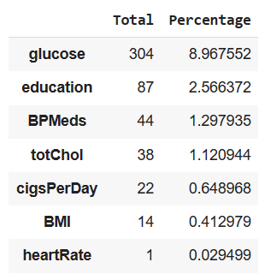
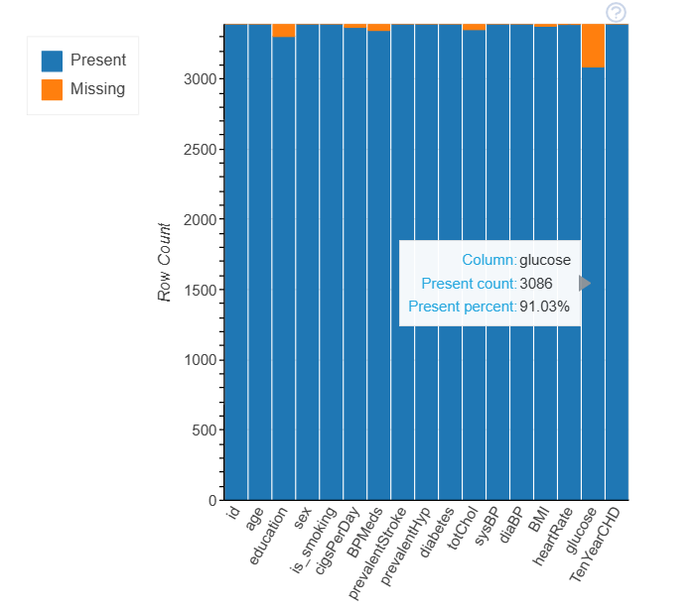
Missing Value Treatment :
At 8.97%, the blood glucose entry has the highest percentage of missing data. The other features have very few missing entries.
Since the missing entries account for only 11% of the total data, we can exclude these entries without losing most of the data.

Slide 8
Exploratory Data Analysis
The EDA for this dataset is done with the help of DataPrep Library.
The goal of create_report is to generate profile reports from a pandas DataFrame. create_report utilises the functionalities and formats the plots from dataprep. It provides the following information:
Overview: detect the types of columns in a dataframe
Variables: variable type, unique values, distinct count, missing values
Quantile statistics like minimum value, Q1, median, Q3, maximum, range, interquartile range
Descriptive statistics like mean, mode, standard deviation, sum, median absolute deviation, coefficient of variation, kurtosis, skewness
Text analysis for length, sample and letter
Correlations: highlighting of highly correlated variables, Spearman, Pearson and Kendall matrices
Missing Values: bar chart, heatmap and spectrum of missing values
In the following, we break down the report into different sections to demonstrate each part of the report.

Slide 9
Integer Treatment
Before we go ahead, an important step to do is to convert our string feature into an integer.
In sex feature M will be converted to 1 and F will be converted to 0 .
In is_smoking feature YES will be converted to 1 and NO will be converted to 0 .

Slide 10
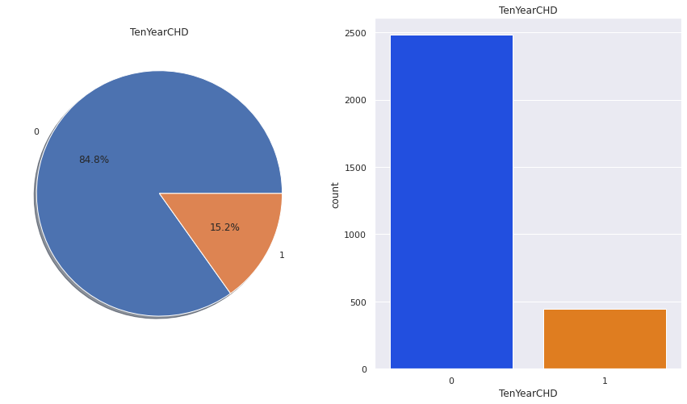
Feature Analysis
Our target variable is TenYearCHD
There are 2483 patients without heart disease and 444 patients with the disease.
1 indicates person have risk of coronary heart disease
0 indicates person do not have risk of coronary heart disease

Slide 11
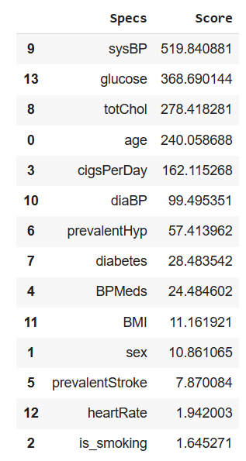
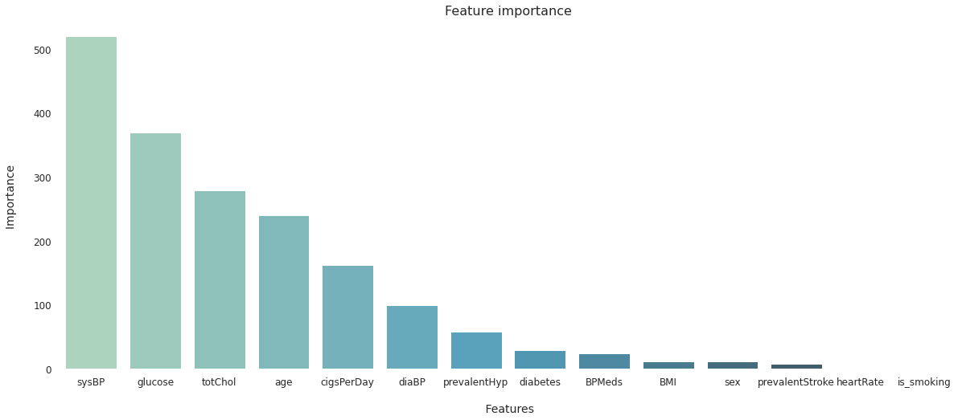
Feature Selection
From above visualisation we can consider features such as sysBP, glucose, totChol, age, cigsPerDay, diaBP who have very scores in model creation.

Slide 12
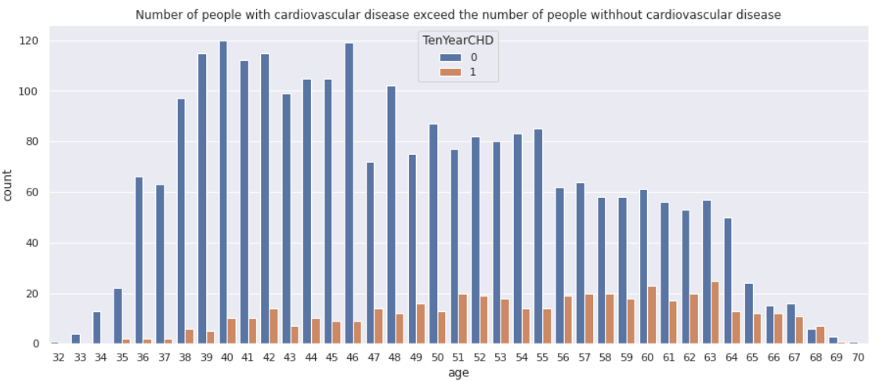
Target Variable Analysis

Slide 13
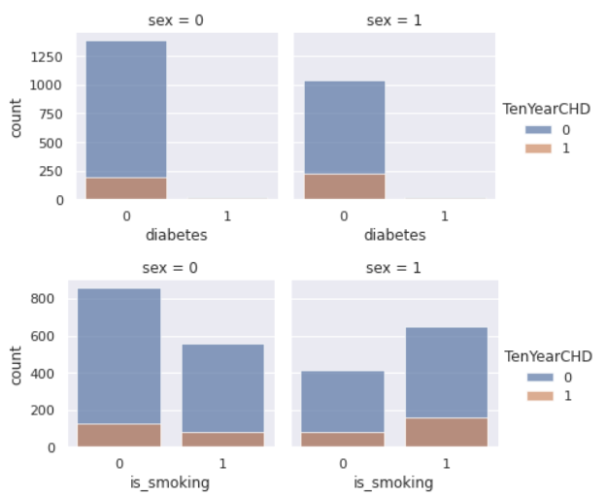
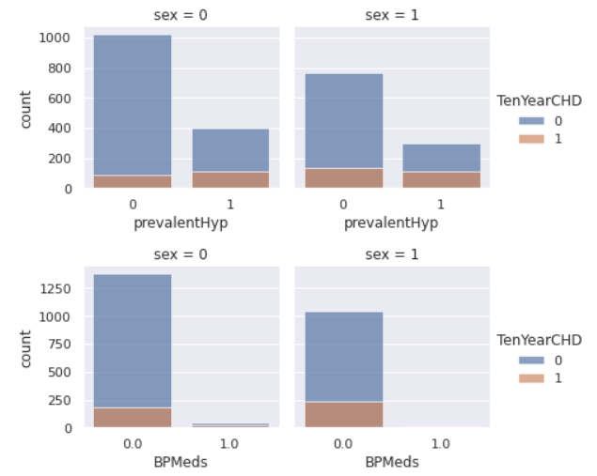
Categorical comparison

Slide 14

Slightly more males are suffering from Cardiovascular heart disease than females.
The people who have Cardiovascular heart disease is almost equal between smokers and non smokers
The percentage of people who have Cardiovascular heart disease is higher among the diabetic patients and also those patients with prevalent hypertension have more risk of Cardiovascular heart disease compare to those who don't have hypertensive problem
The percentage of people who are on medication of blood pressure have more risk of Cardiovascular heart disease compare to those who are not on medication.

Slide 15
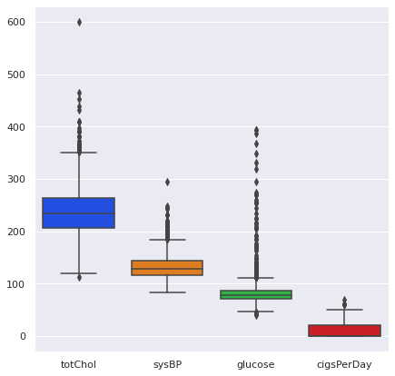
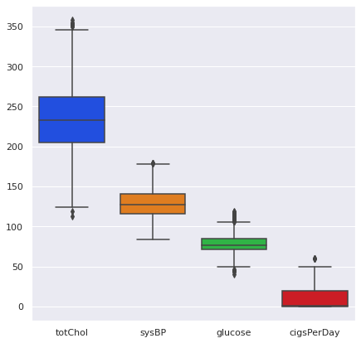
Outlier Treatment:
Before Outlier Treatment
After Outlier Treatment

Slide 16
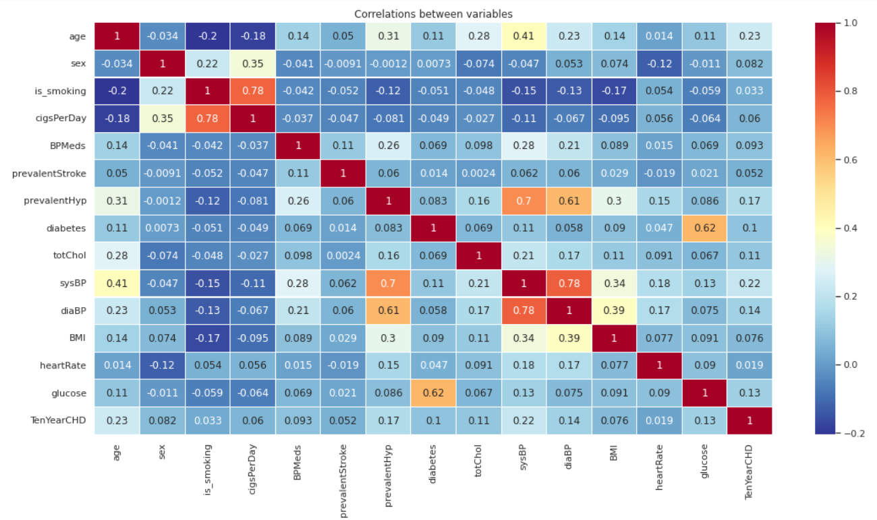
Correlation Analysis

Slide 17
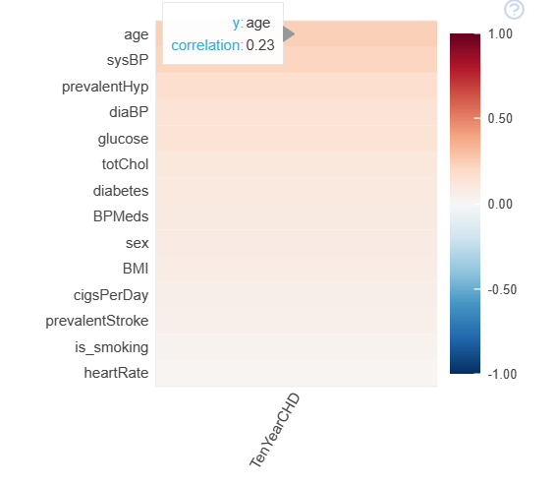
Contd..
There are no features with more than 0.5 correlation with the Ten year risk of developing CHD and this shows that the features a poor predictors.
However the features with the highest correlations are age, prevalent hypertension(prevalentHyp) and systolic blood pressure(sysBP).
Also there are a couple of features that are highly correlated with each other and it makes no sense to use both of them in building a machine learning model.
These includes:
Blood glucose and diabetes;
systolic and diastolic blood pressures;
cigarette smoking and the number of cigarettes smoked per day

Slide 18
Feature Engineering/ Selection:
For feature selection we’ve used Tree-based: SelectFromModel which is an embedded methods use algorithms that have built-in feature selection methods
For feature selection we’ve used Tree-based: SelectFromModel which is an embedded methods use algorithms that have built-in feature selection methods
In Random forest, the final feature importance is the average of all decision tree feature importance.
After performing the feature selection the important features are:
['age', 'totChol, 'sysBP', 'diaBP', 'BMI', 'heartRate', 'glucose']

Slide 19
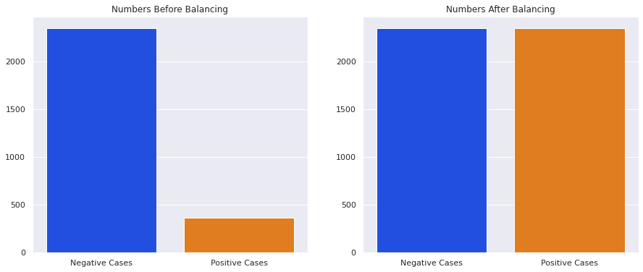
Data Preprocessing:
SMOT - Let’s balance our dataset
First we balance our dataset because for every positive case there are about 5-6 negative cases.
To handle this problem we will balance the dataset using the Synthetic Minority Oversampling Technique (SMOT)

Slide 20
Data Preprocessing:
Split
Data is splitted for test and training purpose.
We have splitted our new balanced data into 80% and 20% split for training and testing.
Metrics
We use evaluation metrics for comparing our model. For this classification problem we have use some metrics and they are as follows:
GridSearchCV: for the selection of best parameters.
confusion_matrix: for evaluation of classification model accuracy.
classification_report: Text report creation for main classification matrix.
Scores: accuracy_score, f1_score, recall_score, prescision_score, roc_auc_score, roc_curve.

Slide 21
Classification models Used:
Here, we’ll be using this 4 algorithms along with GridsearchCV for finding optimum parameters:
Logistic Regression
Random Forest
XGBoost
Support Vector Machine

Slide 22
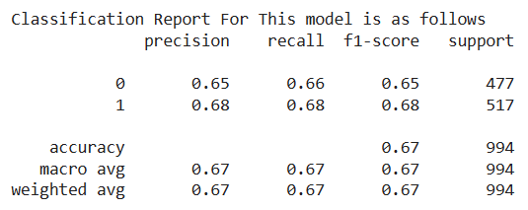
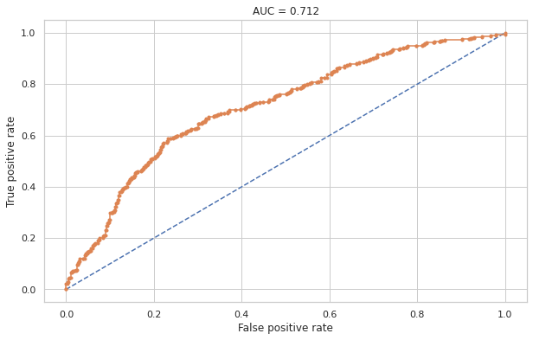
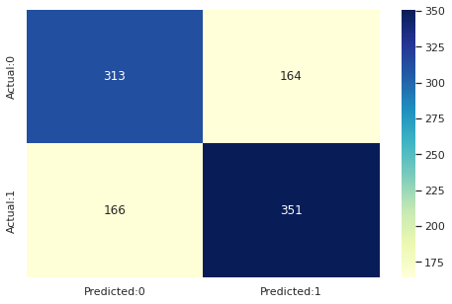
1. Logistic regression :
Best parameters:
{'C': 10,
'class_weight': None, 'penalty': 'l2'}

Slide 23
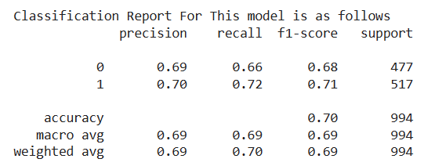
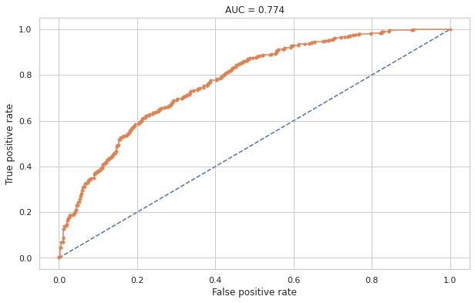
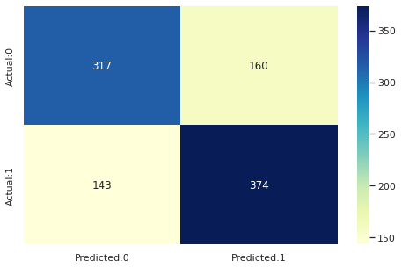
2. Random Forest :
Best parameters:
{'max_depth': 8,
'min_samples_leaf': 40, ‘min_samples_split': 50,
'n_estimators': 80}

Slide 24
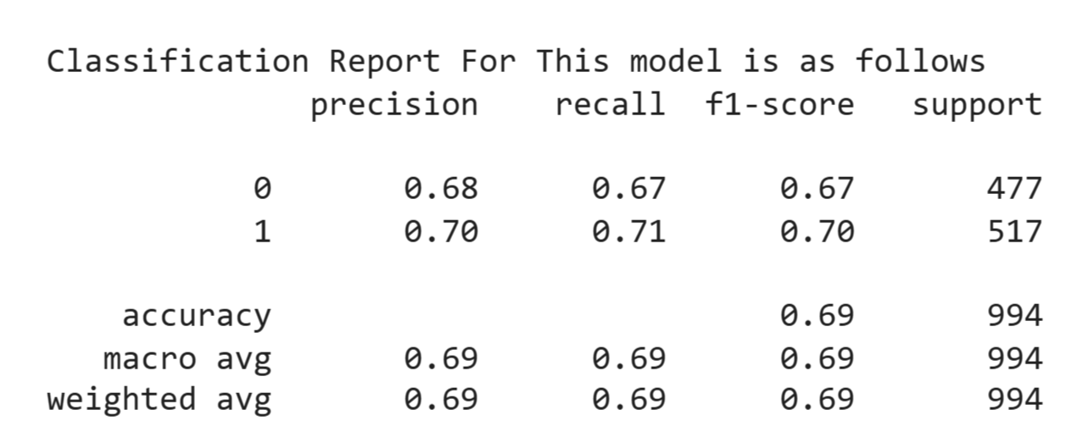

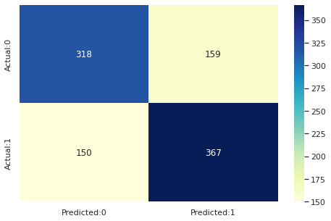
3. XGBoost :
Best parameters:
{'learning_rate': 0.1,
'max_depth': 11,
'n_estimators': 200}

Slide 25
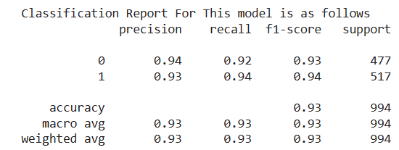
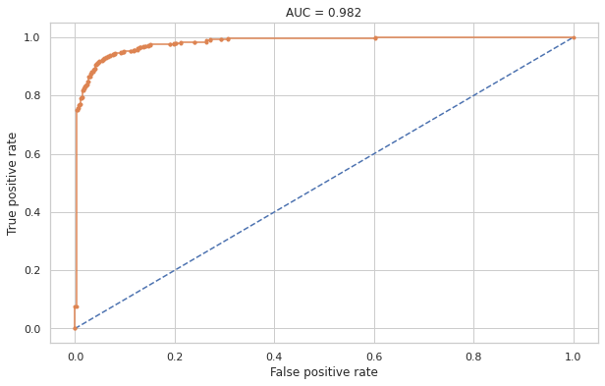
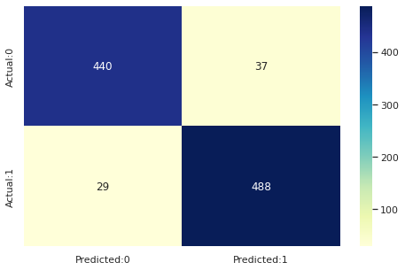
4. Support Vector Machine :
Best parameters:
{'learning_rate': 0.1,
'max_depth': 11,
'n_estimators': 200}

Slide 26
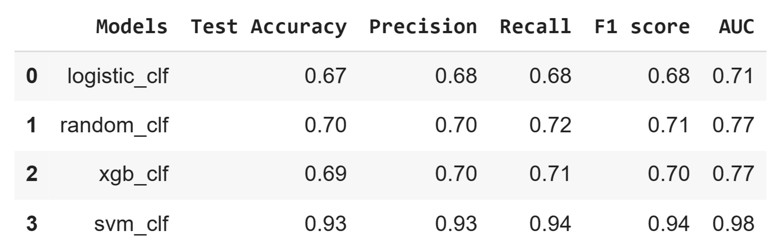
Comparison of Models Performance Metrics:
Observation from above table:
XGBoost, Support vector machine gives highest Accuracy, Recall, Precision and AUC score.
Highest recall and AUC score is given by Support vector machine.
Overall we can say that Support vector machine is the best model that can be used for the risk prediction of Cardiovascular Heart Disease.

Slide 27
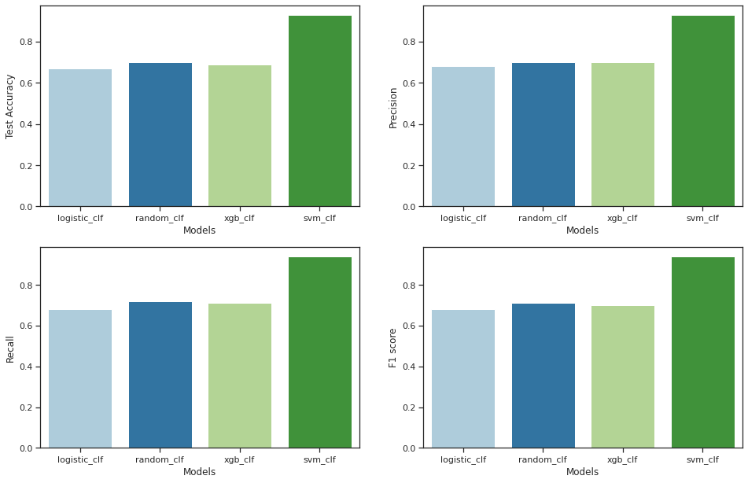
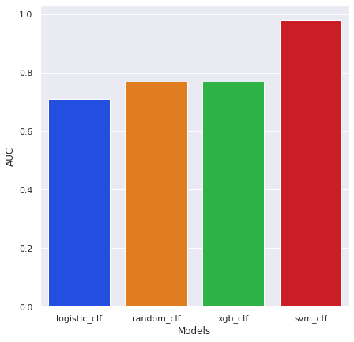
Plotting Accuracy score with respect to each models :
From graphs we can say that the best performing model is Support Vector Machine algorithm.

Slide 28
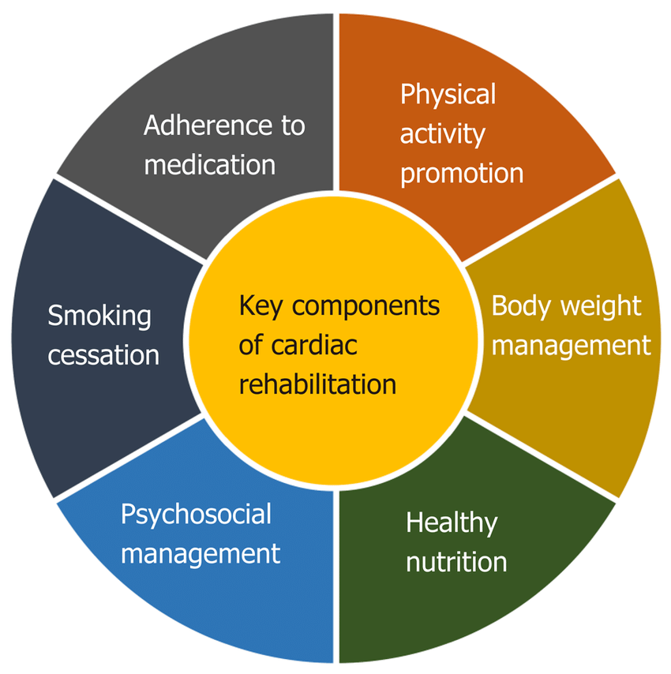
Challenges :
Handling the missing values.
Making data more accurate.
Selection of important features.

Slide 29
Conclusion :
Risk of Cardiovascular heart disease is almost equal between the smokers and non- smokers and same goes with gender it is pretty much same for both male and females.
Correlation obtained is very poor for this dataset but still due to tuned parameters and strong classification algorithms model efficiency obtained is about 93%.
The top contributing features in predicting the ten year risk of developing Cardiovascular Heart Disease are 'age', 'totChol', 'sysBP', 'diaBP', 'BMI', 'heartRate', 'glucose'.
The Support vector machine with the radial kernel is the best performing model in terms of accuracy and the F1 score and Its high AUC-score shows that it has a high true positive rate.
Balancing the dataset by using the SMOTE technique helped in improving the models' sensitivity.
With more data & with more correlated features better models can be built.

